Slide 1
Using Microsoft Social Engagement Together with Dynamics CRM
Jukka Niiranen
2015-11-17

Slide 2
Questions of the day
What main features does MS Social Engagement (MSE) offer today?
How can Dynamics CRM customers take advantage of the standard intergration to MSE?
What type of customization opportunities are there for making use of social data inside CRM?

Slide 3

About me
Dynamics CRM consultant from Helsinki
Working at Digital Illustrated Finland
Dynamics CRM addict since 2005
Frequent blogger & #MSDYNCRM evangelist on social media
Blog: survivingcrm.com
@jukkan on Twitter
Microsoft MVP since 2013
Jukka Niiranen
@jukkan
Consultant @ Digital Illustrated
Microsoft Dynamics CRM MVP

Slide 4
Topics we’ll cover
MSE basics
Licensing
Social profiles
CRM integration
MSE to CRM
CRM to MSE
CRM customization
Mobile
Dashboards
Search topics
Feature roadmap
Analytics
Alerts
Social Center
Activity Map
Social profiles
Social activities
Record creation rules
Channel properties
MSE Link-to-CRM
Navigation
Entity images
Custom entities
Workflows
External profiles
Search
Current limitations

Slide 5
Brief History of MSFT Social

Slide 6

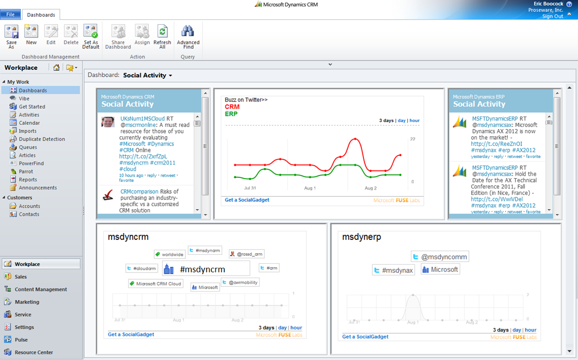
MSFT & Social in 2011: CRM team’s vision
http://www.slideshare.net/lauraannerobinson/building-your-business-hub-microsoft-dynamics-crm-and-social-technologies

Slide 7

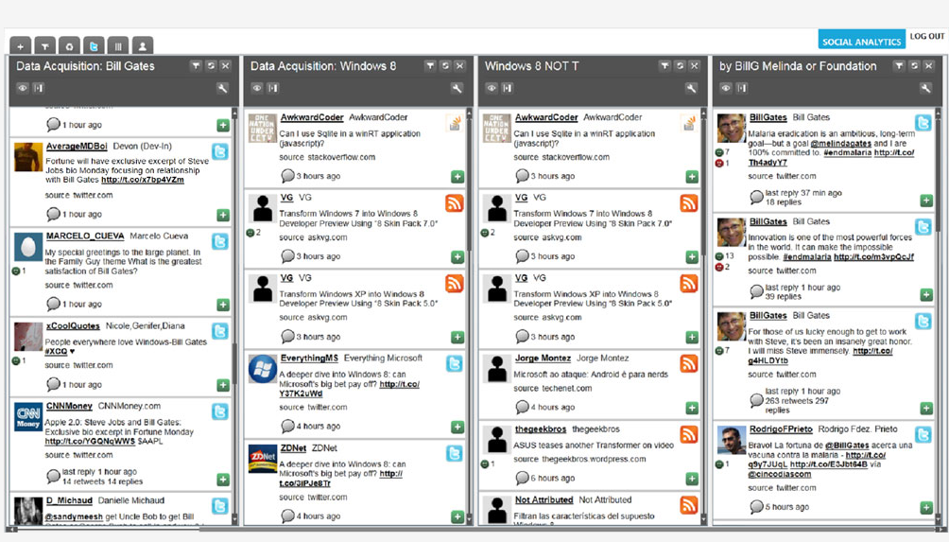
MSFT & Social in 2011: SQL team’s vision
http://www.zdnet.com/article/microsoft-delivers-service-for-integrating-social-web-data-into-business-apps/

Slide 8
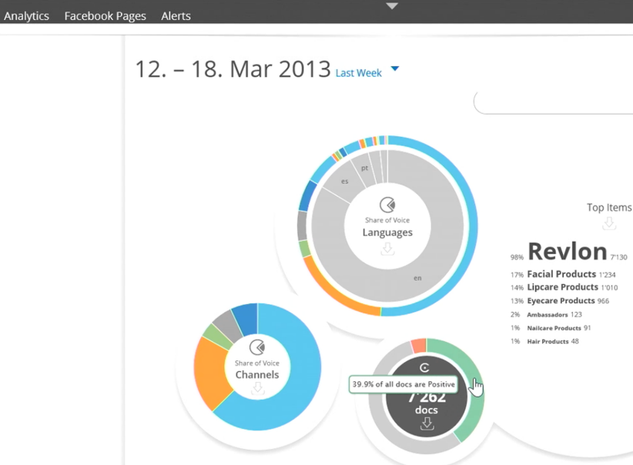
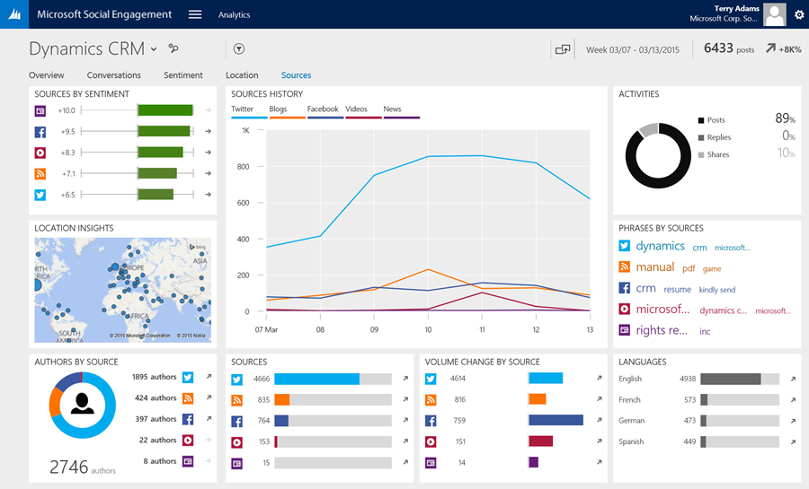
MSFT & Social: making it real
MSFT acquired Swiss company & product ”Netbreeze” in March 2013
Initially branded as ”Microsoft Social Listening”
Rebranded & expanded into ”Microsoft Social Engagement” in 2015

Slide 9
MSE Core Functionality

Slide 10
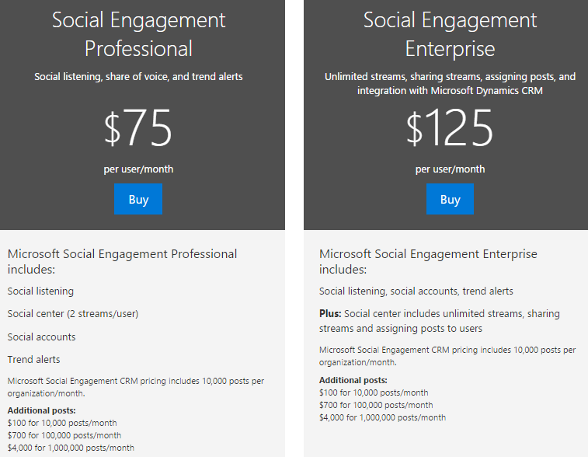
Licensing
MSE Professional
Included in CRM Online Professional (for 10+ users), or purchased separately
Access (almost) all MSE features
Search 10k posts/month
MSE Enterprise
Included in CRM Online Enterprise, or purchased separately
Required for linking MSE posts to CRM

Slide 11
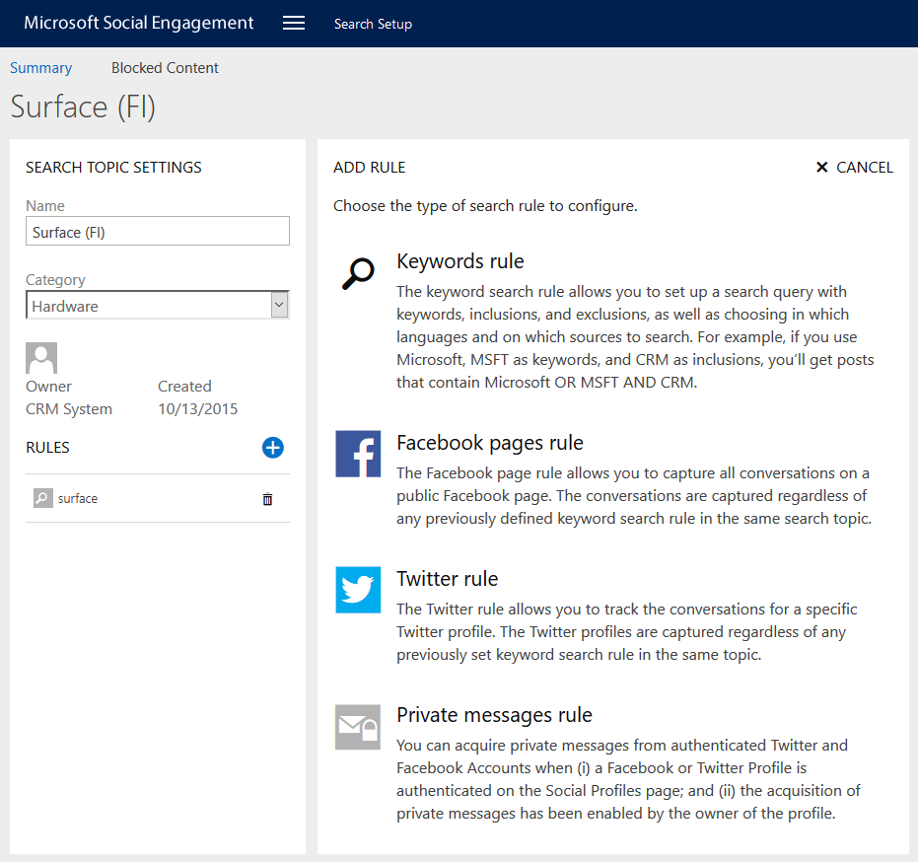
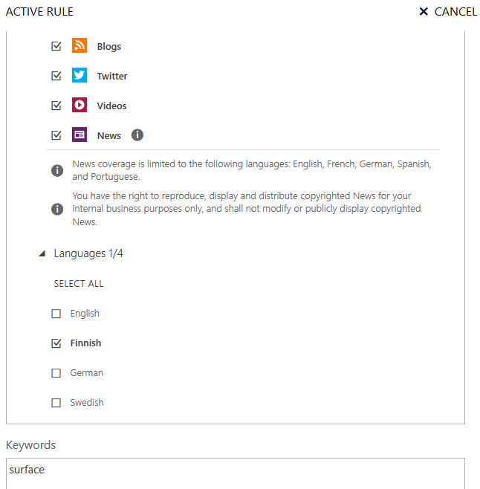
Search Topics
Keyword rules are targeted to sources & languages, with sets of keyword inclusion/exclusion rules
Topics consist of rules for either keyword search or specific FB page / Twitter profile

Slide 12
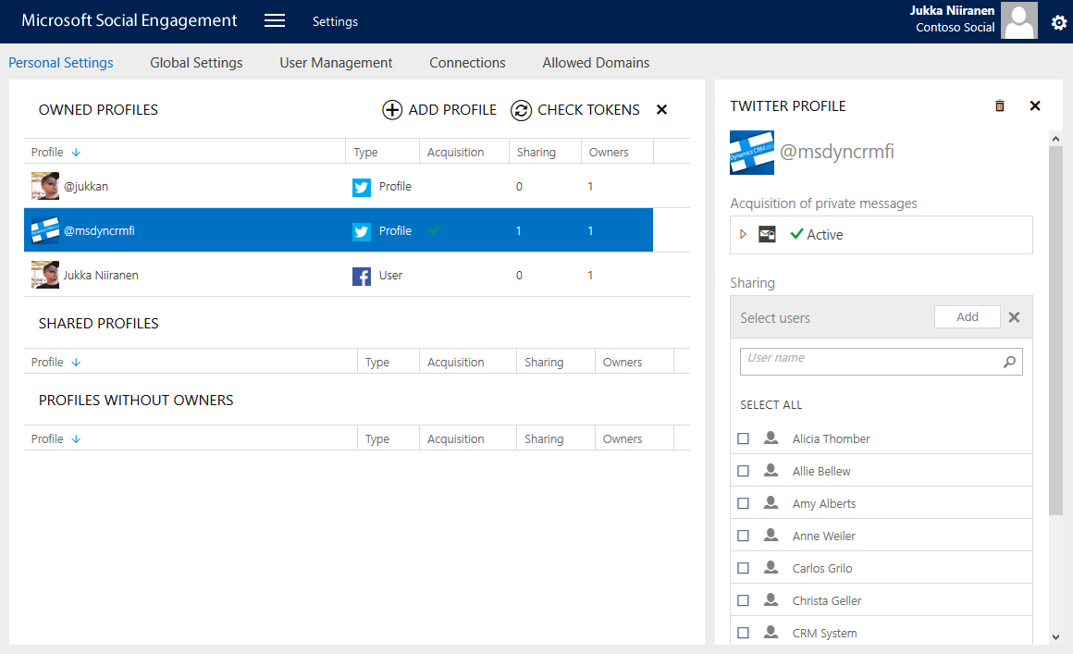
Social Profiles
Authorize MSE to post from your Twitter & FB profiles
Authorize other MSE users to posts as shared profiles

Slide 13
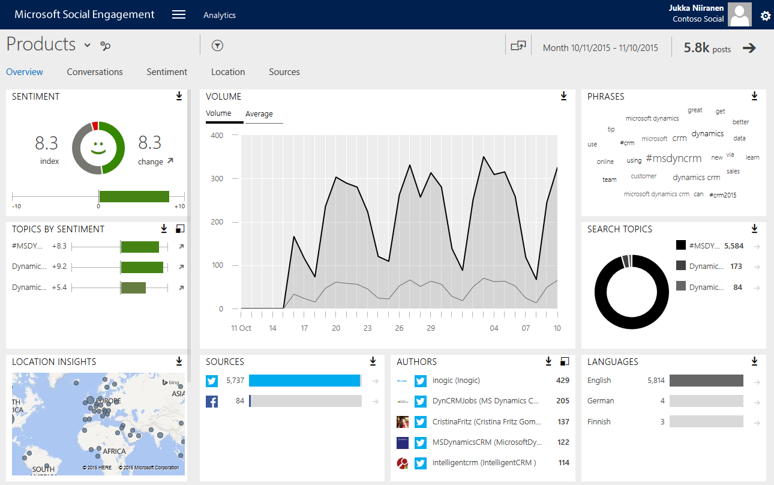
Analytics: overview
Analyze post data via 5 preconfigured dashboards
Download data to Excel
Drill into charts for details

Slide 14
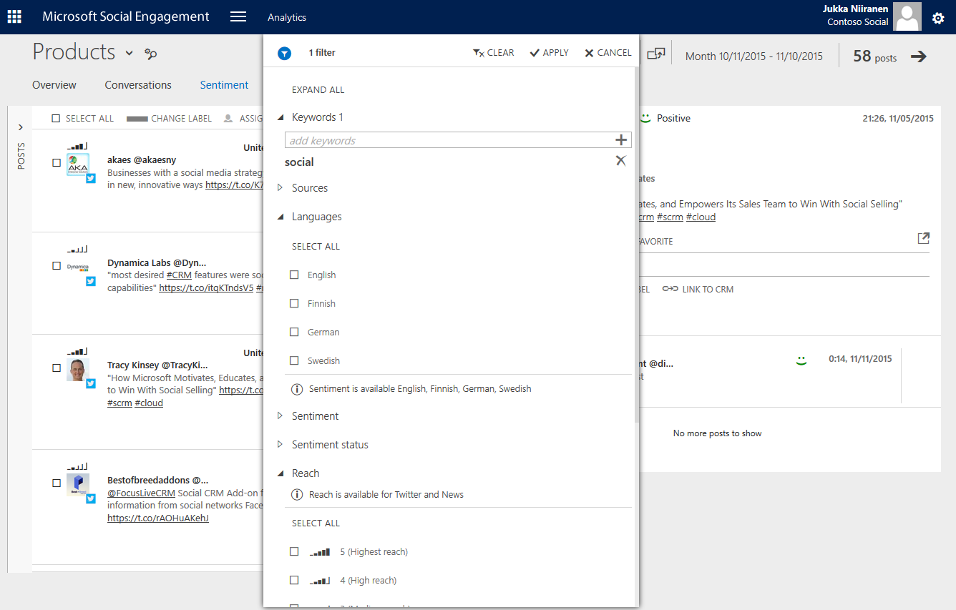
Analytics: posts & filters
Filter analysis data set by keyword, source, language, sentiment, reach, location...
Drill into stream of matching posts

Slide 15
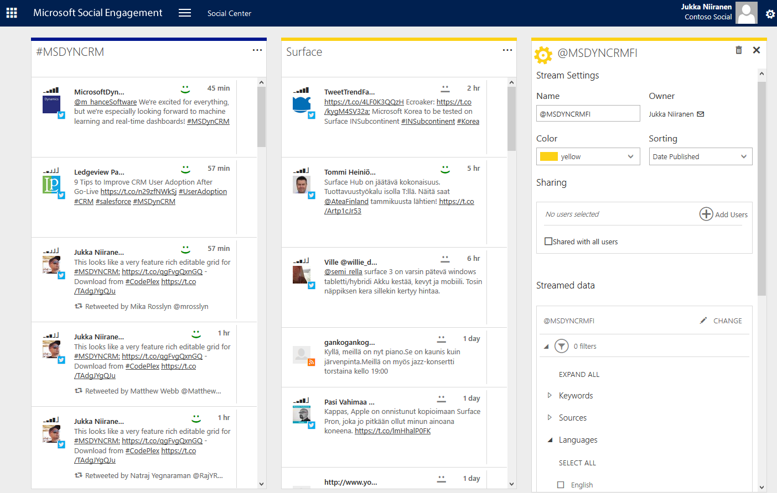
Social Center
Configure personal set of post streams to follow
Filter stream content, share streams with other users

Slide 16
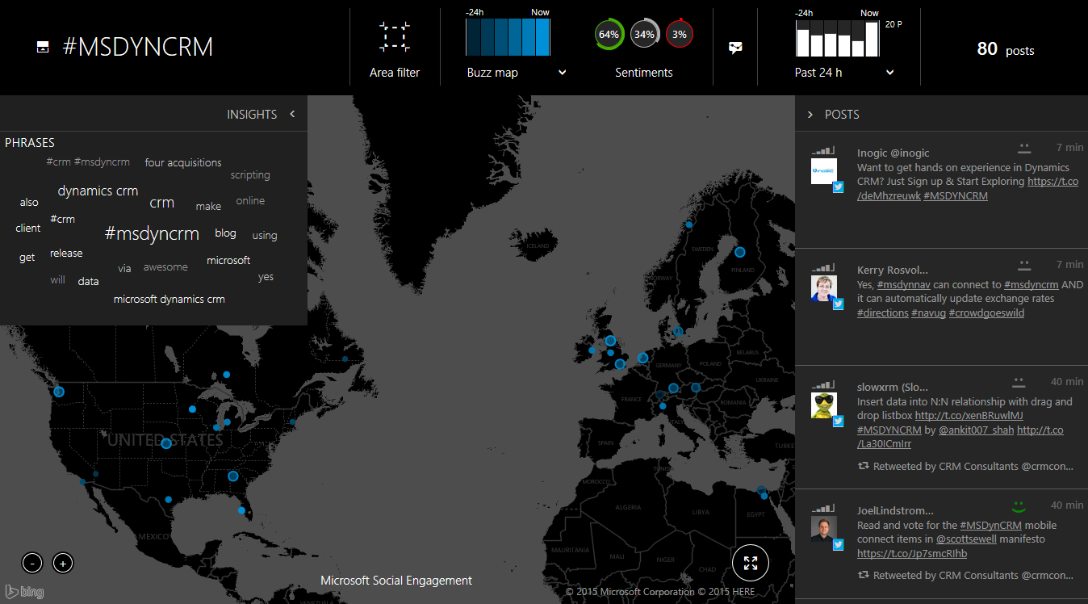
Activity Map
Show live buzz/sentiment map of posts from last 30min – 24h

Slide 17
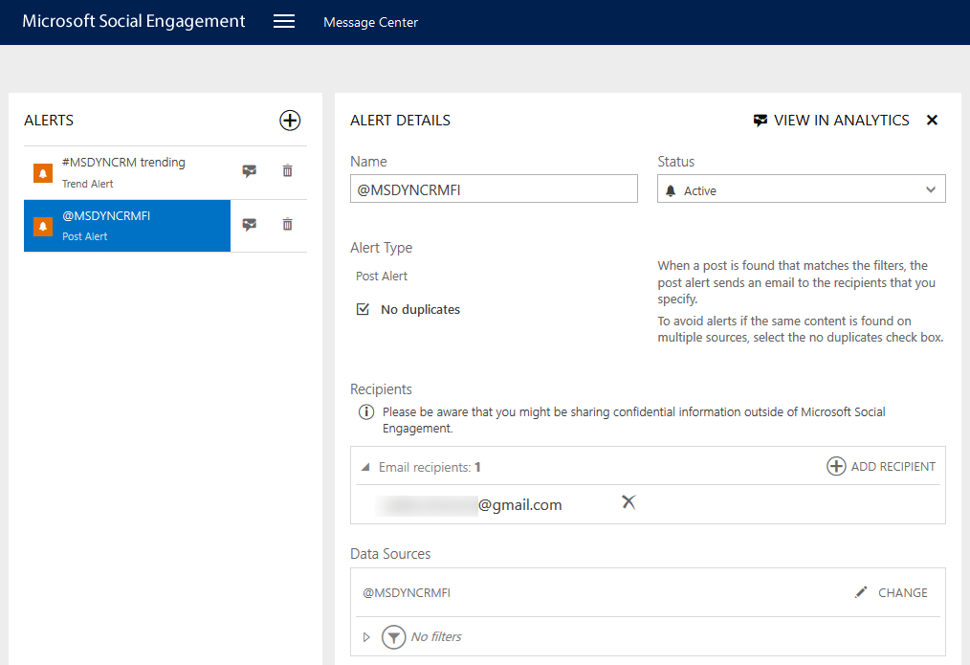
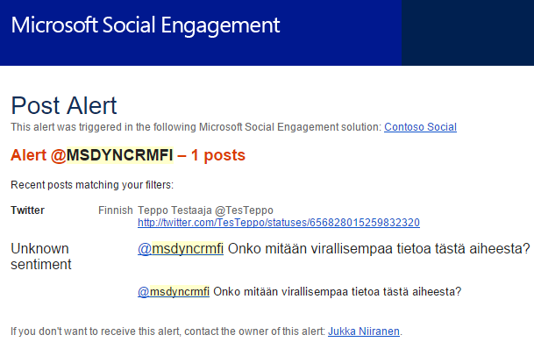
Alerts
Deliver email notifications to specific addresses when alert criteria is met
Set up trend or post alerts for specific searches or accounts

Slide 18
MSE feature development
MSE is currently adding new features with a monthly release cadence
2015 Update 1.2 (http://bit.ly/mse15u12): link social posts to CRM
2016 Update 1 (http://bit.ly/mse16u1): create new posts, not just replies
More social channels coming in future releases, incl. custom sources via RSS
Currently only Facebook & Twitter supported
More sentiment languages continuously added
Currently 20 for search language, 15 for sentiment analysis
Keep an eye on the ”What’s New” page for Social Engagement at http://bit.ly/msenew
Read about MSE 2016 roadmap from ”Get Ready” page for Dynamics CRM at http://bit.ly/crmnext

Slide 19
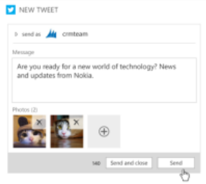
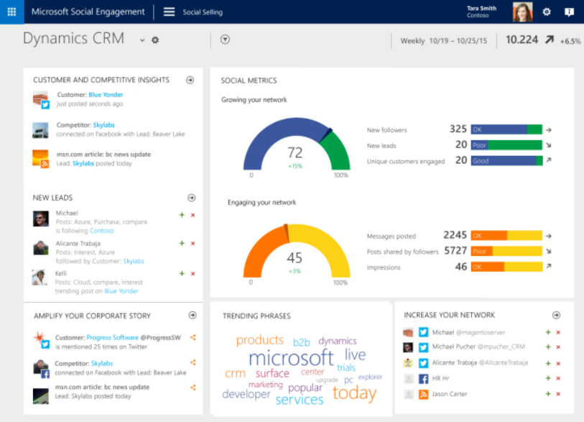
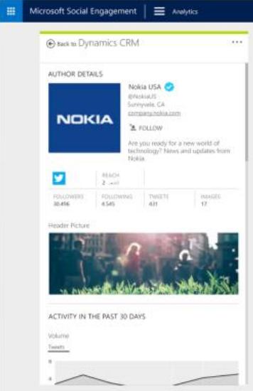
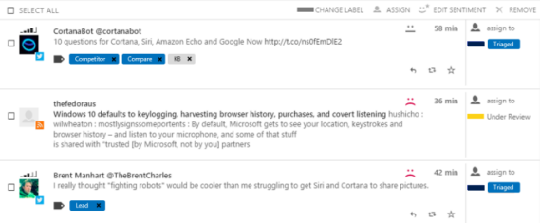
MSE 2016 roadmap items
Create new posts, not just replies
Social Selling app for sales users
View author profiles
Automatic tagging of posts

Slide 20
MSE and CRM Integration

Slide 21
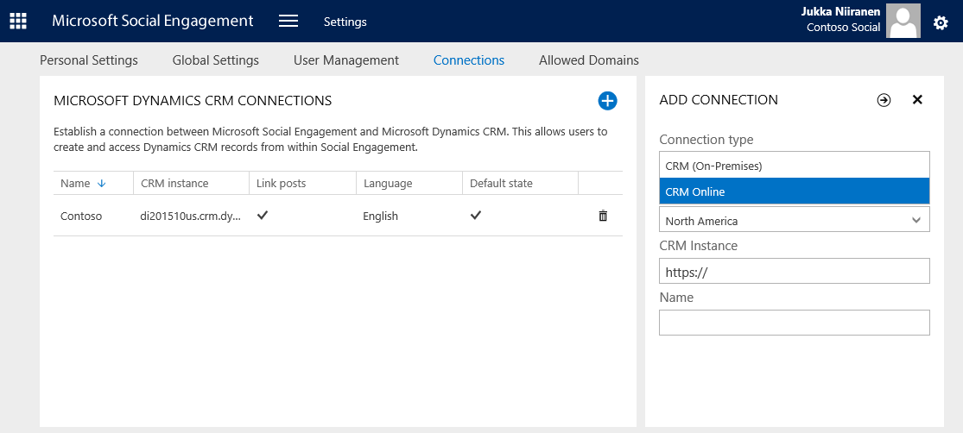
Connecting MSE to CRM
Integration used for pushing social posts & profiles to CRM
Currently only CRM Online 2015 Update 1 supported, on-prem support coming with 2016
Must be in same tenant as MSE if Online
One MSE can talk to multiple CRM instances
One instance can be set as default to linked posts

Slide 22
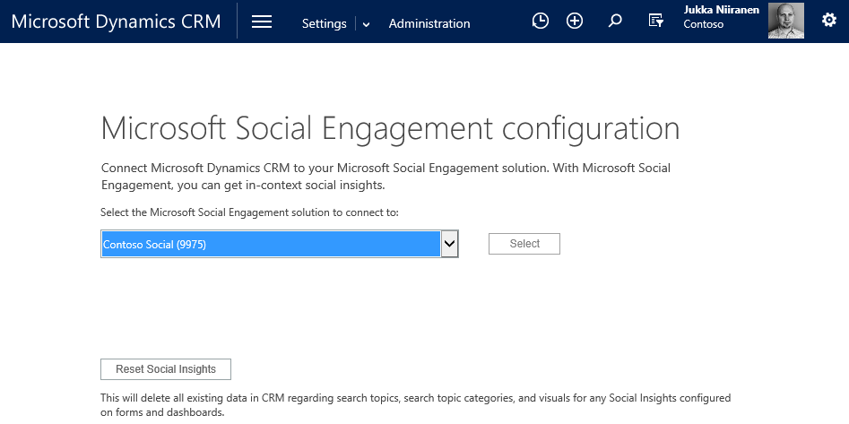
Connecting CRM to MSE
Integration used for showing embedded widgets from MSE in CRM forms and dashboards
Supports both CRM Online and on-premises, starting from CRM 2015
Only user interface level ”integration”, CRM doesn’t send any data back to MSE

Slide 23
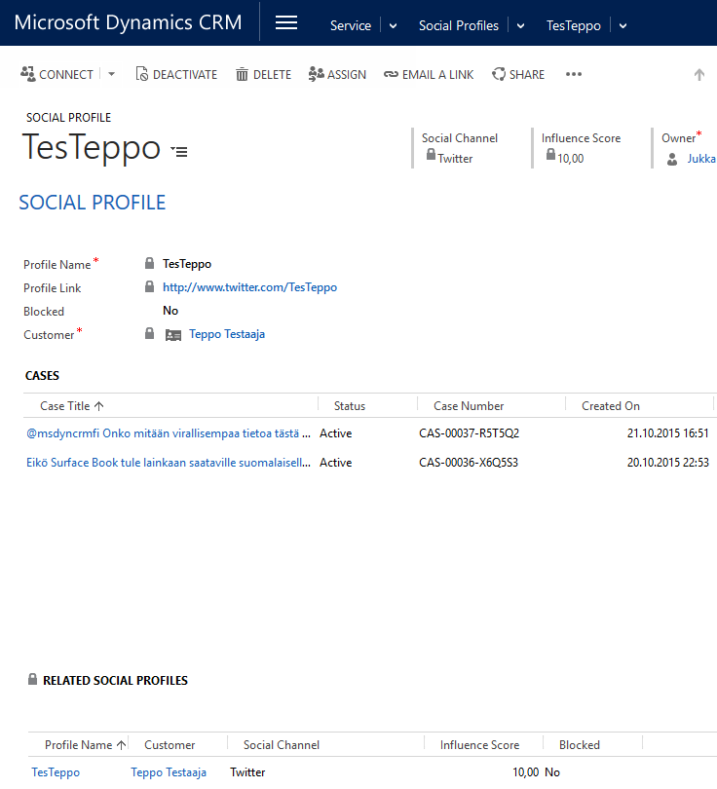
Social Profiles in CRM
Created by MSE the first time you link a social post into CRM
Cannot be created in CRM manually
Are not matched to existing CRM contacts, duplicate contacts need to be manually merged
Customer is always contact, not account

Slide 24
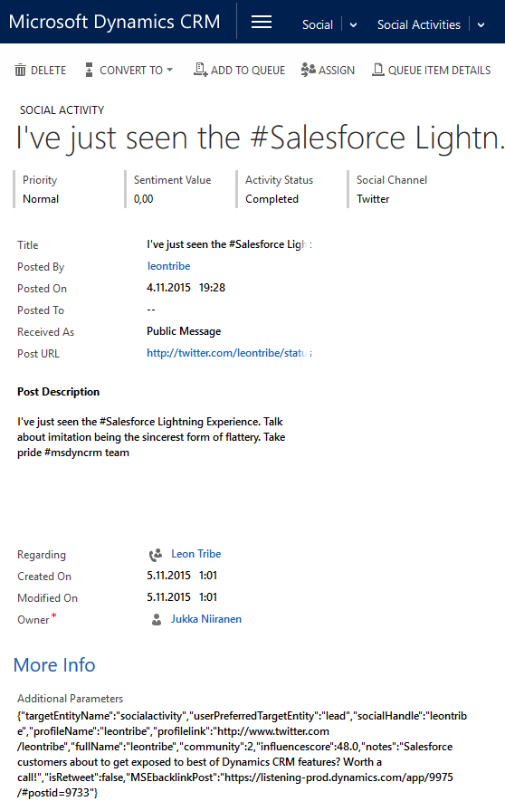
Social Activities in CRM
Created by MSE every time you use Link-to-CRM feature
Cannot be created in CRM manually
Contain both the post attributes (post text, date, channel, social profile) as well as JSON payload with more channel specific properties

Slide 25
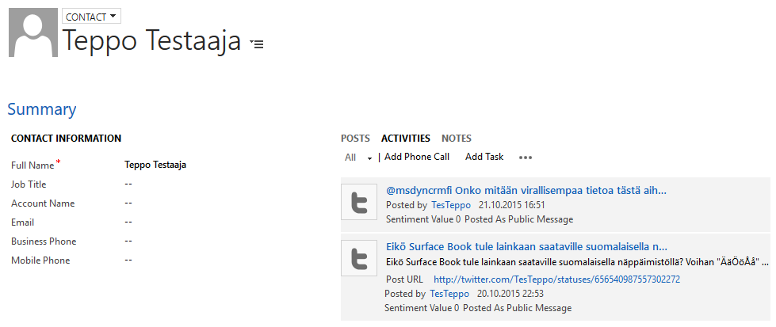
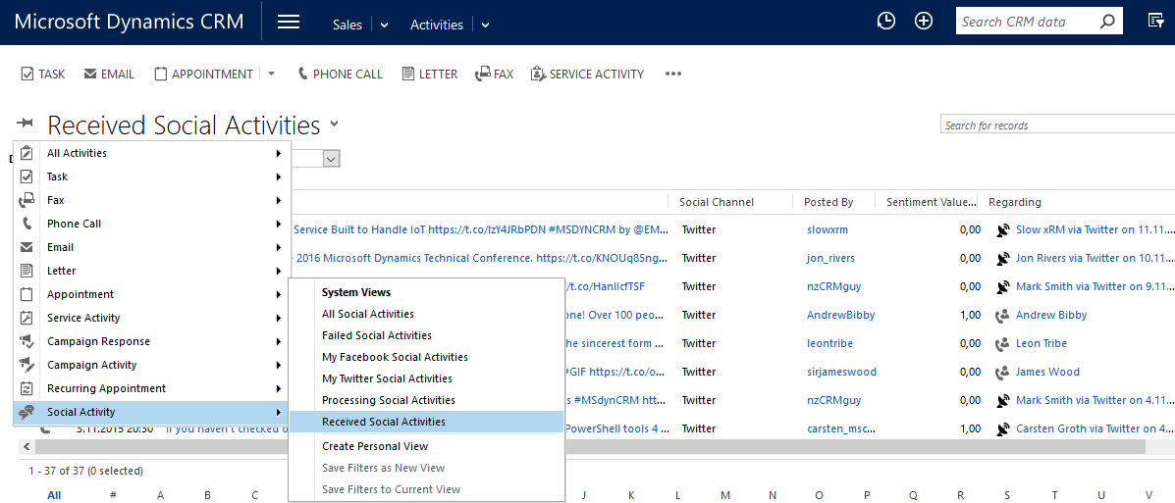
Social Activities in CRM (2)
Shown in standard activity views related to the contact, including rollup to parent account’s activity history
Can be directly accessed from standard activity menus, to query social activities across different customers

Slide 26
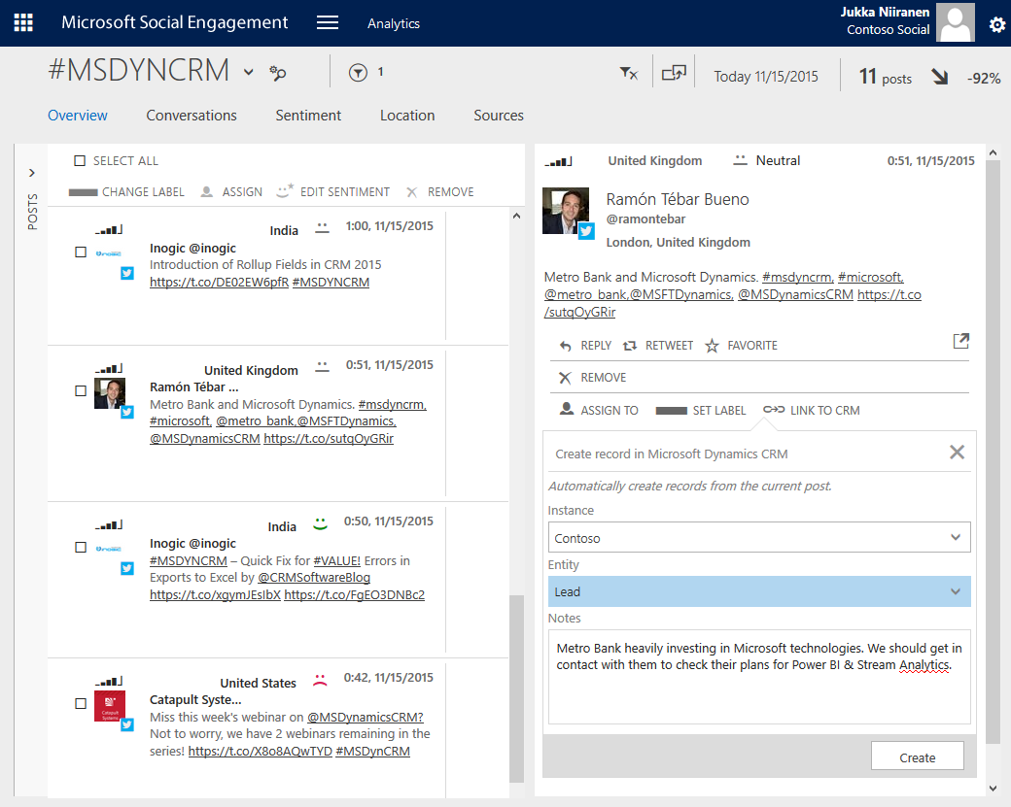
Linking MSE posts to CRM
Open the post, click ”Link to CRM”(select CRM instance if more than one)
Choose target entity, e.g. lead, case
Enter free text notes (optional)
Click ”Create” to send info to CRM

Slide 27
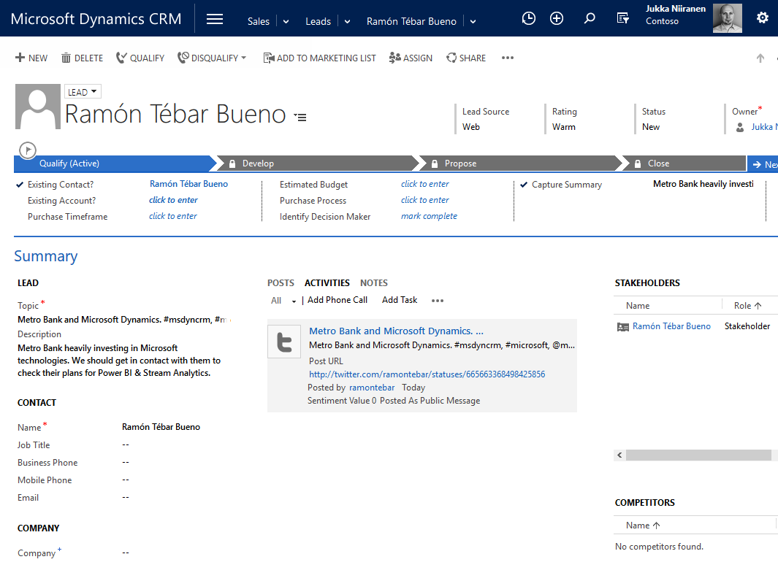
Example of new CRM lead created from MSE post
New contact + social profile created from the post
New lead created with post topic and user notes from MSE
Social post linked to activity history of lead, contact (+ account, if exists)

Slide 28
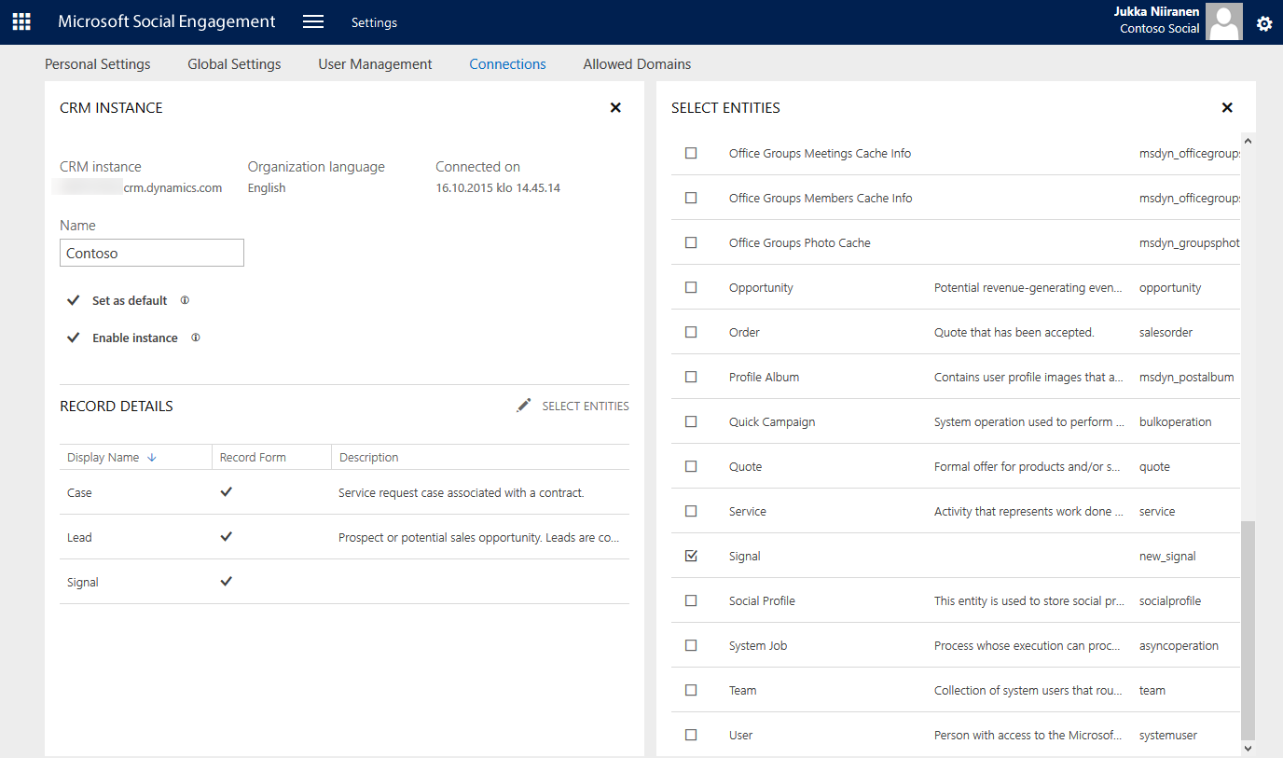
Choosing CRM entities available in MSE
You can enable/disable CRM instance specific entities to be available in the ”Link to CRM” dialog for MSE posts
MSE socia posts can be converted to many default and all custom CRM entities

Slide 29
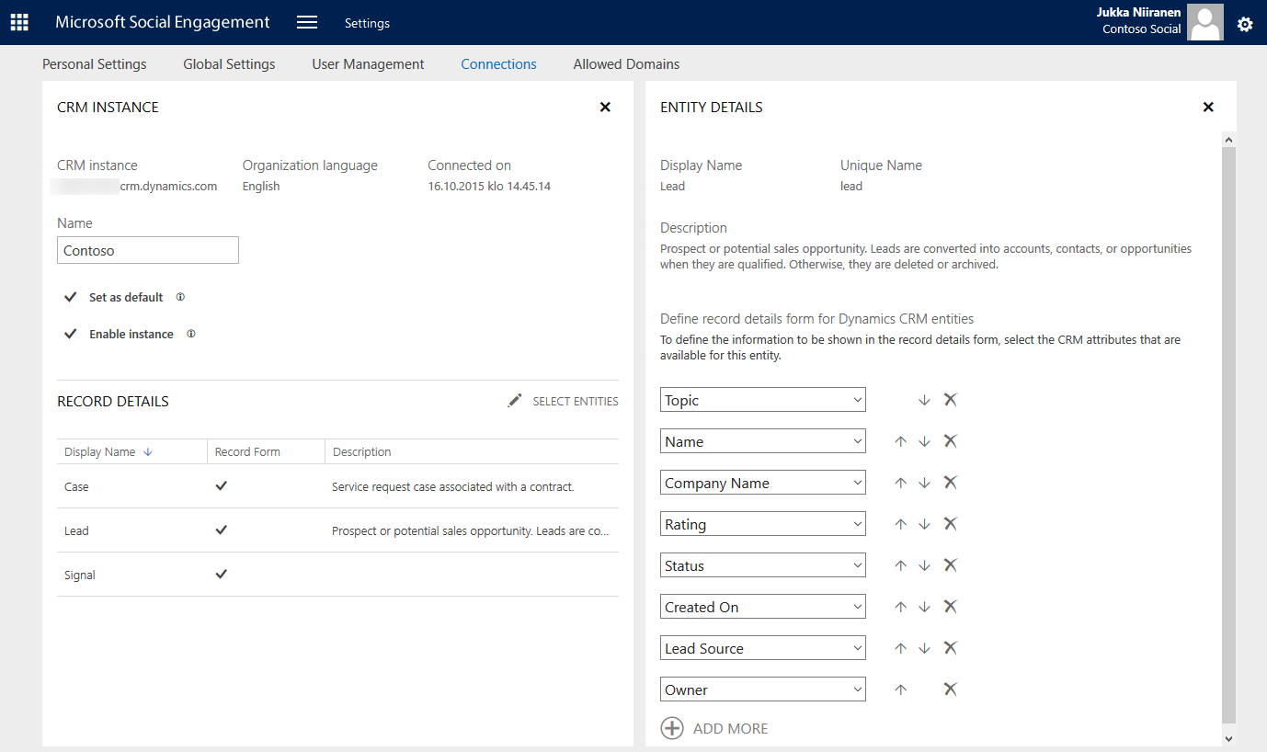
Configuring fields available across MSE and CRM
You don’t configure the field mapping from MSE to CRM here, instead you’ll leverage CRM Record Creation Rules
What you can specify in MSE is what fields from the CRM entity should be shown in the preview when viewing the linked record via MSE UI

Slide 30
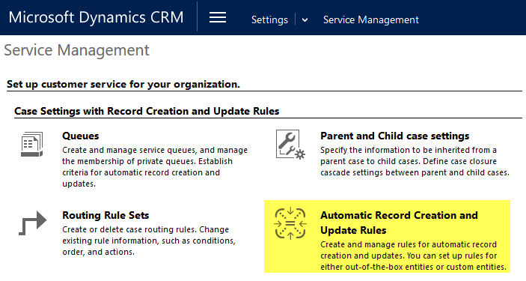
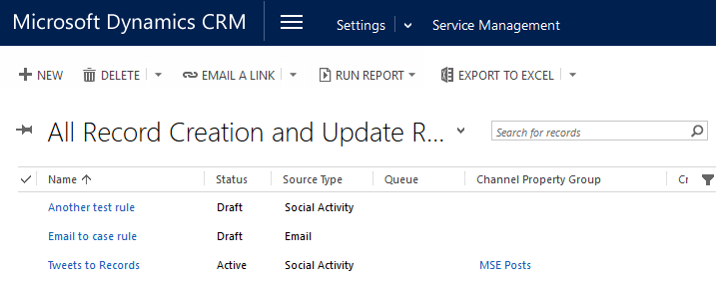
Using CRM Record Creation Rules
MSE will only ever create Social Profiles & Social Posts to CRM
All the business logic for creating other records is managed in CRM via Record Creation and Update Rules
First introduced as ”Case Creation Rules” in CRM 2013 SP1
Expanded into general purpose rules in CRM Online 2015 Update 1

Slide 31
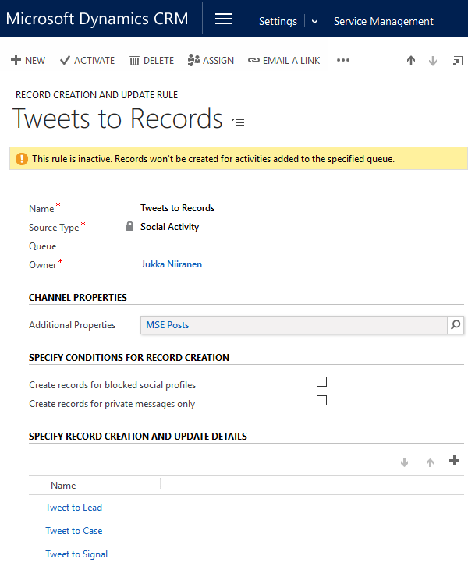
Configure your Record Creation Rules
Choose source activity type
Emails & Social Activities have specific built-in conditions available
Configure Channel Properties
Process additional parameters of the source activity record
Add & order Record Creation Details (= Rule Items)
Execute the business logic for target records to create & other processes (workflows)

Slide 32
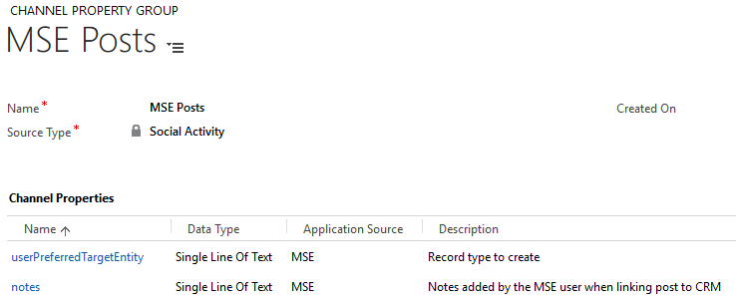
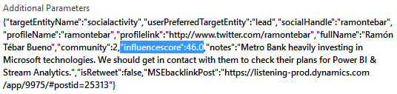
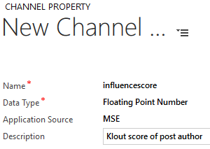
Configuring Channel Properties
Channel Properties will be available for the business logic in your record creation rules
You must ”parse” them from the Social Activity Additional Parameters field (JSON payload)
Examples:
userPreferredTargetEntity = entity chosen by MSE user in ”Link to CRM” dialog
notes = text entered by MSE user

Slide 33
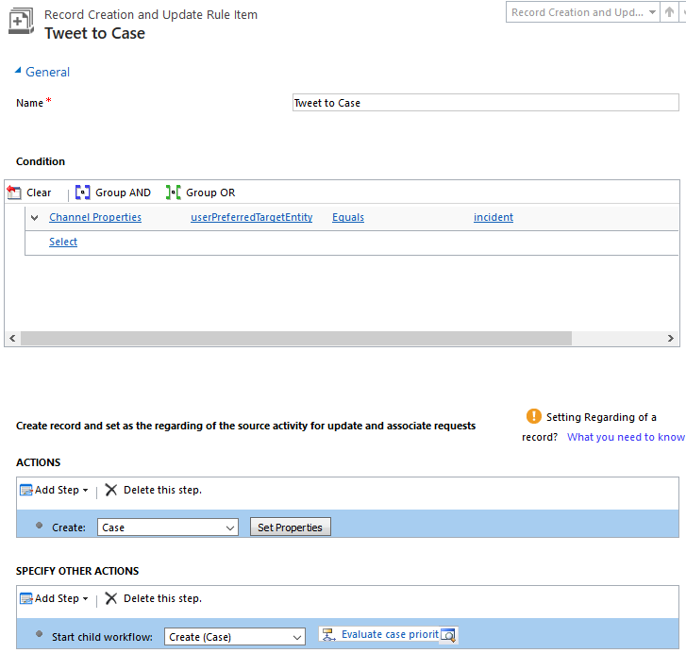
Configuring Record Creation Rule Items
Rule Items evaluate a condition against the source activity
E.g. ”did the user choose this social post to be created as a Case entity record?”
If Rule Item condition is met, the actions are performed
E.g. create a case, send email notification, start child workflow process to evaluate more complex business logic

Slide 34
Current limitations with MSE-CRM integration
”Link to CRM” in MSE will always create a new record, can’t link to existing records in CRM
E.g. Case created into CRM will only show the first social post, not replies & discussion threads
No option to link just a new Social Activity to an existing Social Profile without creating a new Regarding record in the process
Social Profiles are matched only against existing profiles, not existing contacats
Profiles are not linked to existing customer records until you merge the new duplicate contacts created by MSE in CRM

Slide 35
MSE and CRM Customization

Slide 36
Social Post & Profile entities customizability
Can add new fields and views
Can customize forms
Can’t create additional forms
Can have charts and appear on dashboards
Can be accessed via workflows
Can be used in Phone & Tablet client

Slide 37
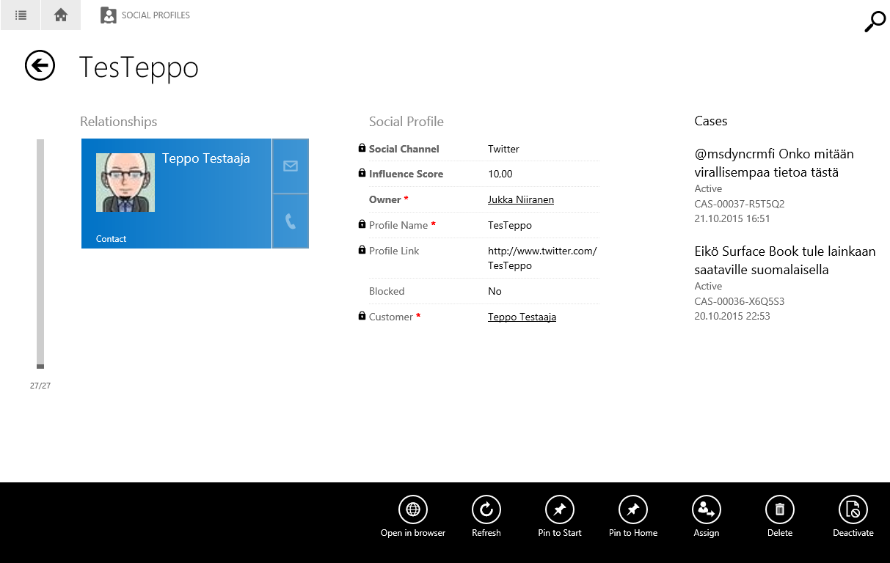
Social Profile viewed on CRM Tablet client

Slide 38
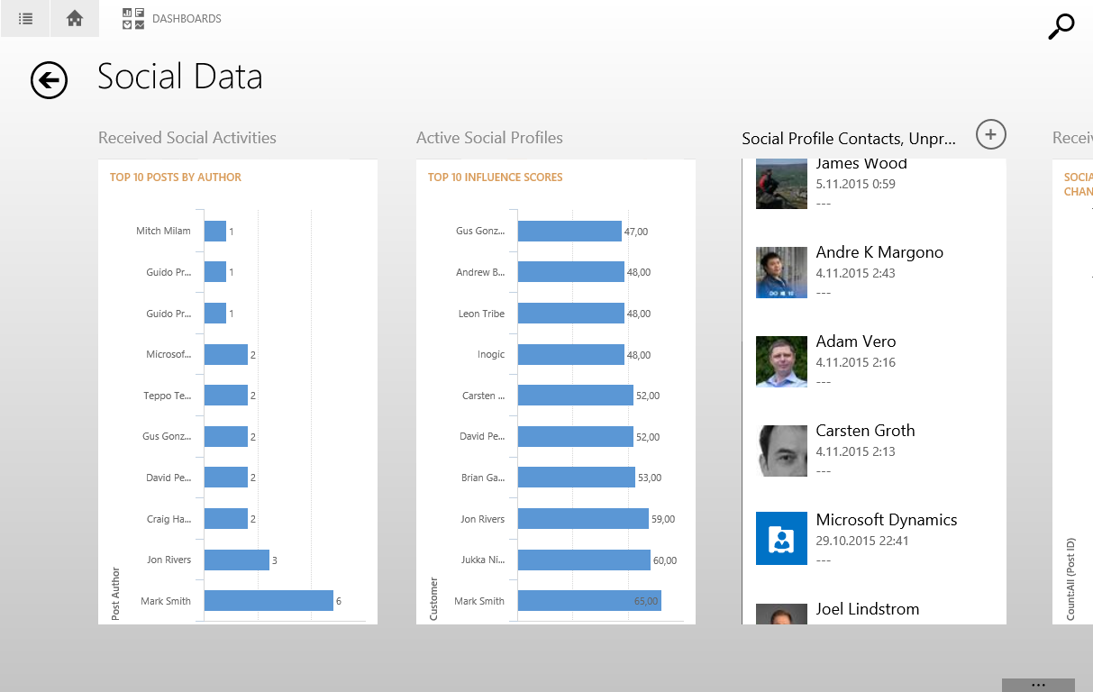
Social data viewed via dashboard on Tablet client

Slide 39
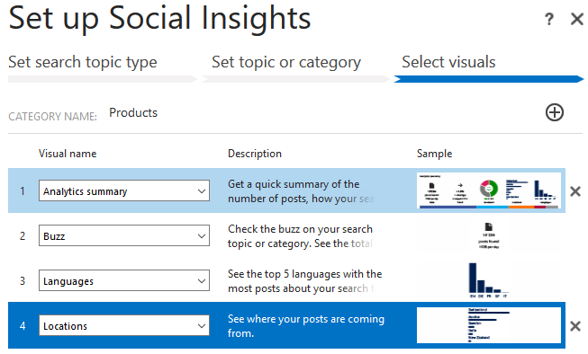
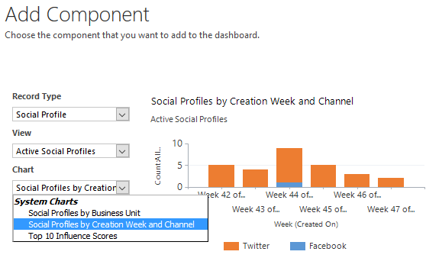
Social dashboard options
Using CRM-to-MSE integration
Embed Social Insights widgets to create a search topic specific dashboard
Data loaded from MSE, license required, drill through to MSE
Using MSE-to-CRM integration
Build new view filters and charts for Social Profile and Social Activity entities
Combine with any related entity, available to all CRM users, drill down

Slide 40
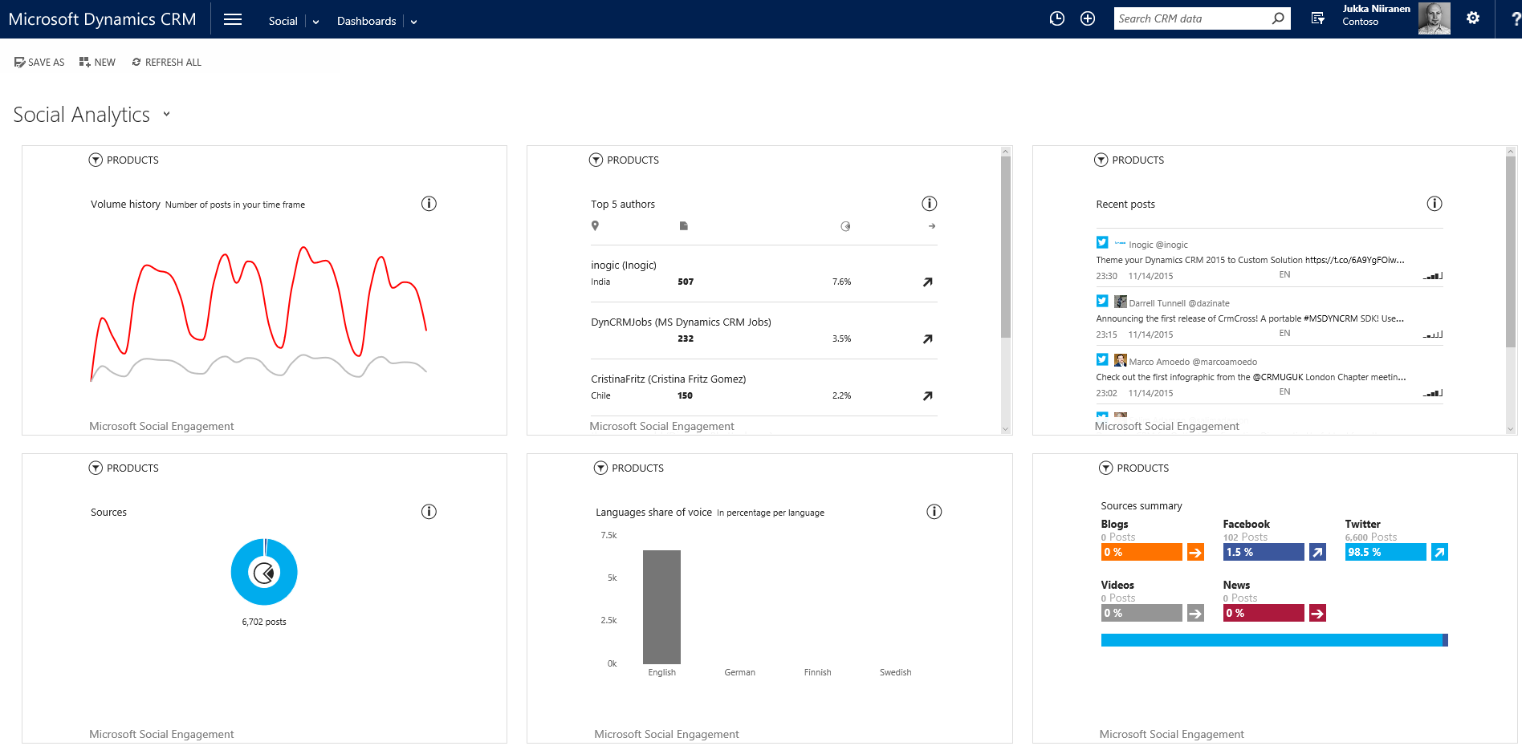
Social dashboard for MSE widget data

Slide 41
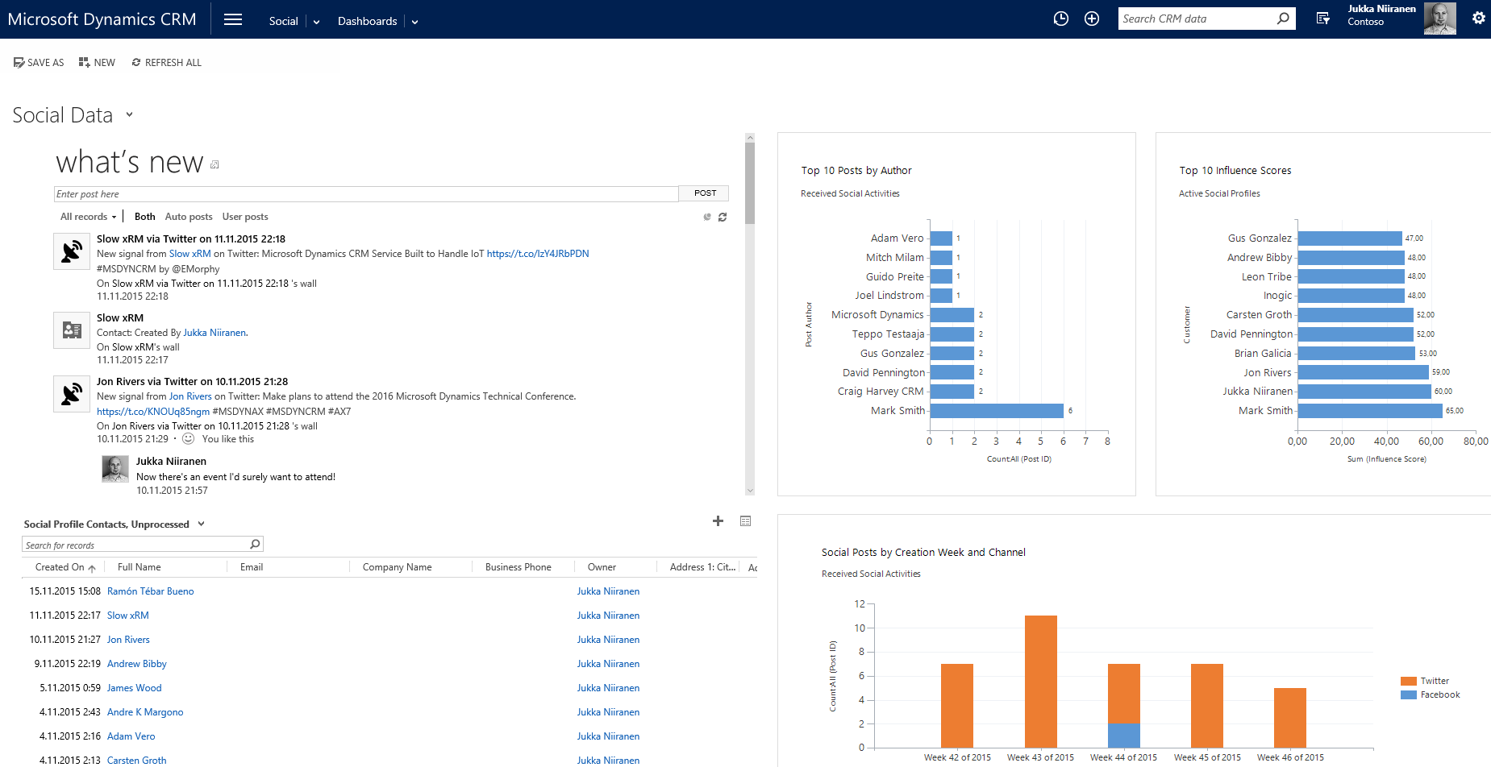
Social dashboard for CRM data

Slide 42
Custom entity for tracking social posts
For non-service scenarios, every relevant customer tweet is not going to be a lead
To use Link-to-CRM you need to always choose some entity, though
If you want to track important social posts related to customers, partners or competitors into your CRM contacts database, you can create a custom entity, like ”Signal”
Choose this when linking tweets & FB posts into CRM contacts as records in their activity history
Leverage CRM workflows to populate fields, process user notes, send notifications...

Slide 43
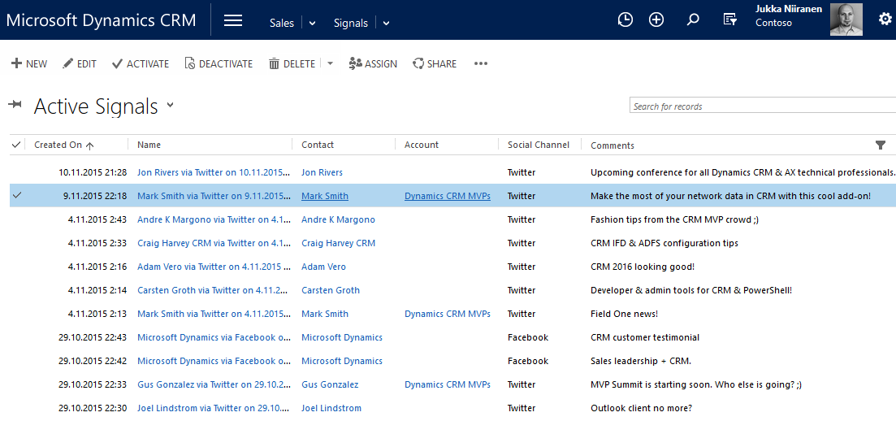
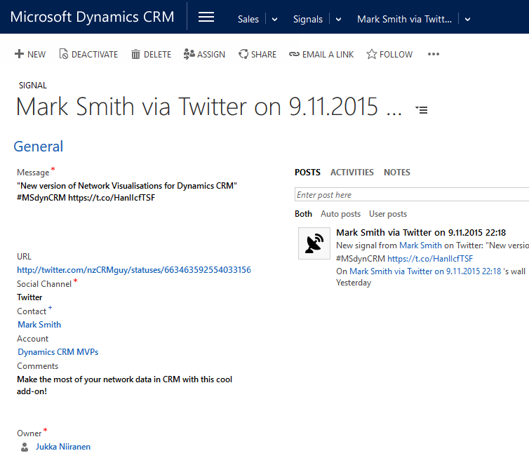
Social Signals in CRM
Latest signals can be viewed, filtered and searched
Data from original social post copied to Signal field with workflow
MSE user notes also available for context & comments

Slide 44
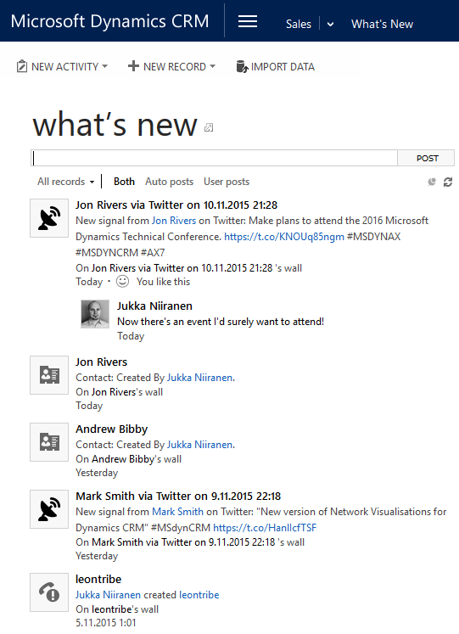
CRM Activity Feeds for following social signals
You can also leverage CRM Activity Feeds for automatic status updates on new Signals
Use workflow process to create new AF post on the contact’s wall
All CRM users who follow these contacts will see the updates in their What’s New home feed

Slide 45
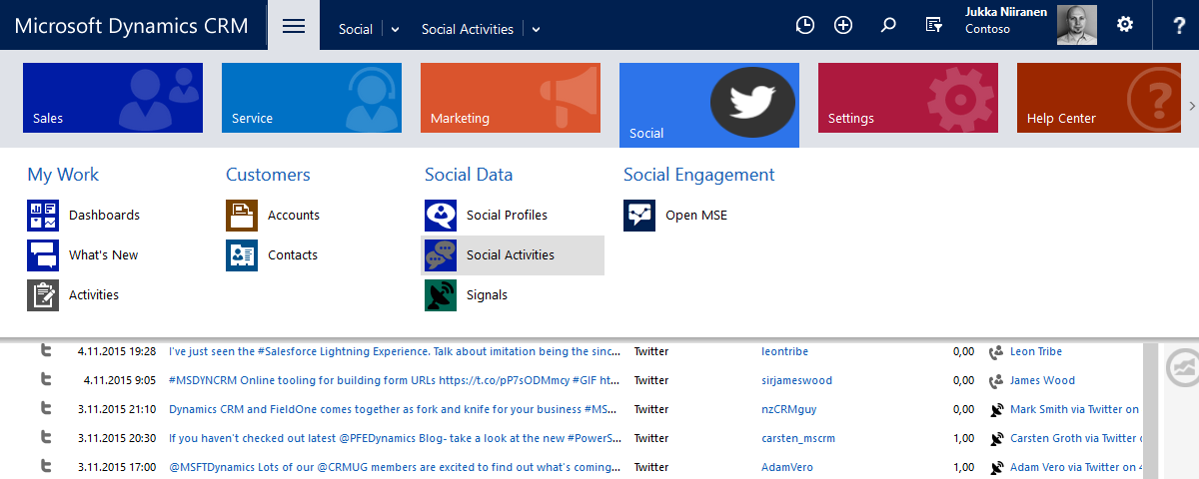
Adding Social menu items to CRM Sitemap
Make social data more prominent to CRM users by adding them into the main Nav Bar
Use a tool like XrmToolBox to create a new sitemap area, add links to social entities, set default dashboard

Slide 46
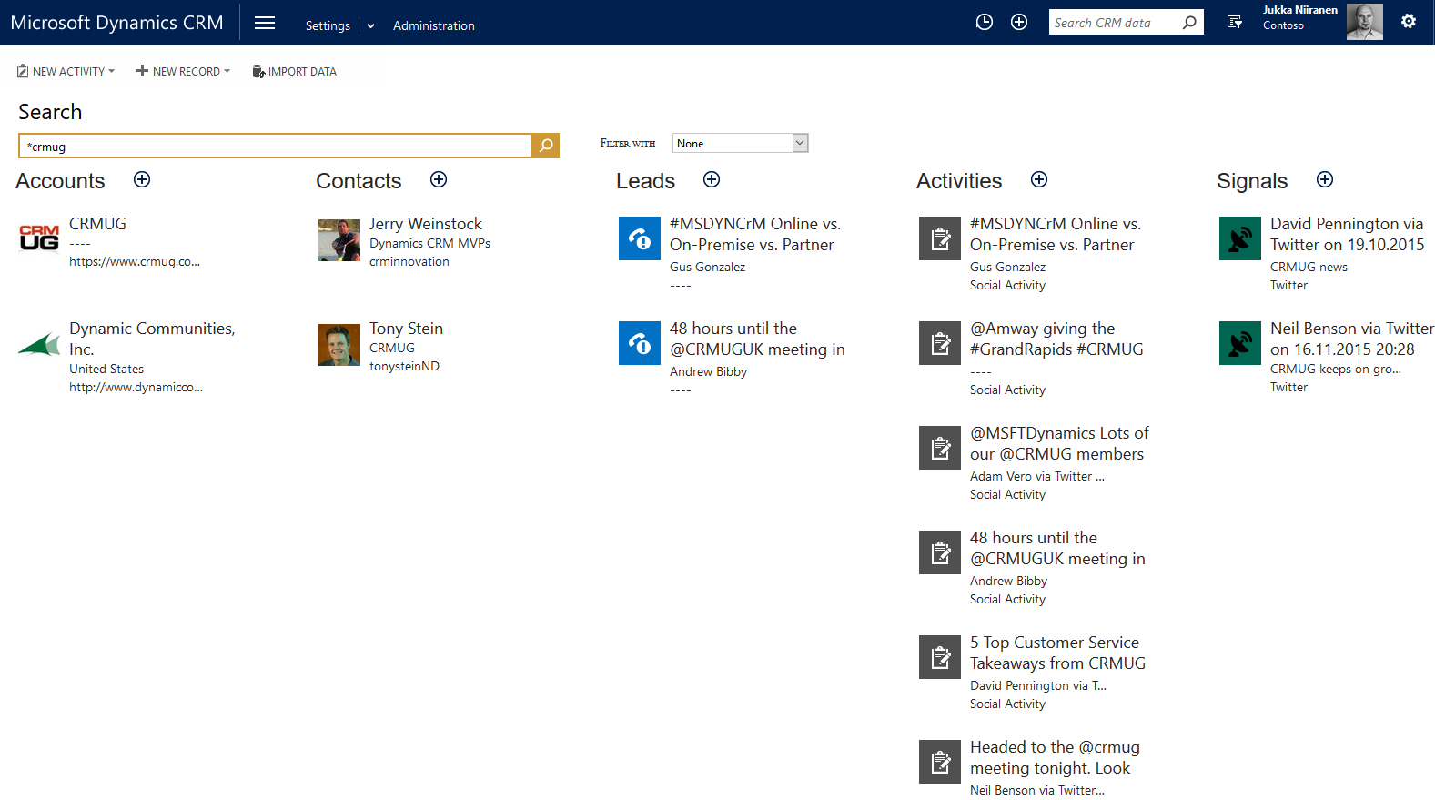
Searching for social data
Contents of Social Posts & Profiles can be searched via standard Multi-entity Quick Find
Tip: new Relevance Search in CRM 2016 will make the social data search much smarter!
#itwillbeawesome

Slide 47
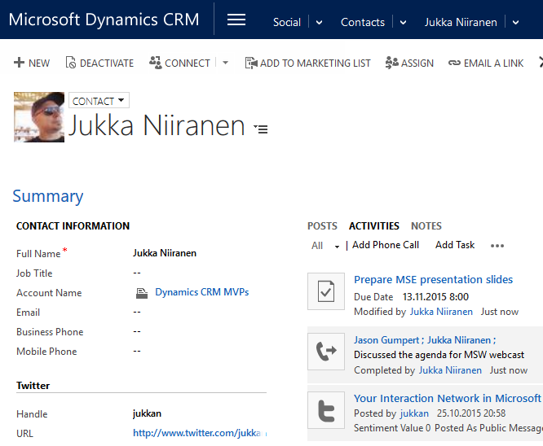
Copy Twitter handles to Contact records
Social Profiles associated to a contact will be visible in related records, via 1:N relationship
Sometimes it might be nice to see them directly as links on the contact form, though
You can create a workflow process for Social Profile entity to easily achieve this

Slide 48
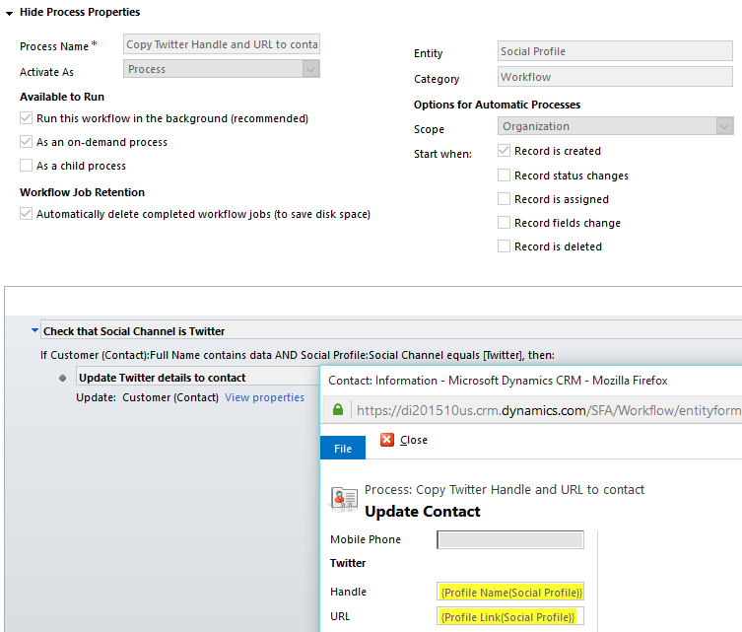
Workflow process on Social Profile create
Trigger the process on create of new Social Profile
Check that the Social Profile is for the right channel
Update your custom fields on the contact

Slide 49
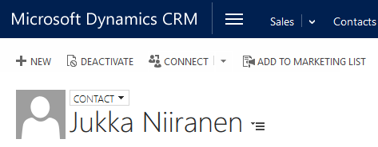
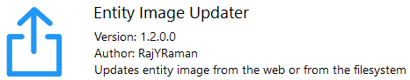

Updating entity images
MSE doesn’t sync the social profile’s user image to CRM contacts
By storing Twitter handles on CRM contacts, we can use this data to query pfofile image APIs
Entity Image Updater by Natraj Yegnaraman (for XrmToolBox) allows you to run bulk updates to selected set of contacts and match their profile images with services like Twitter, Gravatar, Clearbit, or even local folders
Get it from:
http://bit.ly/crmimg

Slide 50

Updating entity images (2)
1. Select field to use for profile image matching
2. Limit the target contacts with FetchXML query criteria, if needed
3. Matched images are updated to CRM records

Slide 51

Embedding external profiles to CRM forms
Having social profile names stored on contact also enables using them in form scripts, to dynamically retrieve data from external websites or widgets
Example: add an iFrame to contact form, use OnLoad script to open https://klout.com/[profile] to view the customer’s social influence score & areas of expertise
function setKloutIFrameURL() {
var IFrame = Xrm.Page.ui.controls.get("IFRAME_Klout");
var twitterHandle = Xrm.Page.data.entity.attributes.get("new_twitterhandle").getValue();
var newTarget= "https://klout.com/"+twitterHandle;
IFrame.setSrc(newTarget);
}

Slide 52
Thanks for your time!
For more Social Engagement and Dynamics CRM related content,
visit http://survivingcrm.com/

Slide 53

Keep on #MSDynCRM:ing!

